Slide 1

PERSONALISED LEARNING ASSISTANT
Gowreesh Gunupati
Katyaini Raj
Priyanka Gujar
Advisor: Dr. Fatema Nafa
DS 5500 Capstone Final Project Presentation

Slide 2
CONTENTS
MOTIVATION
METHODOLOGY
TIME SCHEDULE
What's the goal?
What did we implement?
What is our key milestones?
RESULTS
EVALUATION
SUMMARY & REFLECTION
What our application looks like?
How good is our model?
The Final Verdict!
2

Slide 3
MOTIVATION
3

Slide 4
PROBLEM STATEMENT
Students find it hard to assess their understanding effectively
Educators often struggle with curating questions or summaries from large volumes of text
4

Slide 5
OBJECTIVE
Automated quiz generation and summarization from files (PDFs, Word, PPT), URLs and text box using on-device LLMs (LLaMA, Gemma)
Streamlit frontend with Python backend for seamless interaction
On-device processing for privacy and offline functionality
Real-time integration of web articles and YouTube videos for enhanced learning
5

Slide 6
IMPACT
Reduces the time and effort required to create study materials
Enhances accessibility to tailored educational content
Supports learners with diverse needs by providing customizable inputs
6

Slide 7
HYPOTHESIS
Model Variability: The suitability of each model for specific educational applications
Processing Efficiency: On-device models will show comparable latency to cloud models while being more cost-effective and open-source
Question Difficulty: LLMs can generate questions of varying difficulty, with prompting techniques influencing model responses and interaction
7

Slide 8
AMENDMENTS
Description: Removed image upload functionality from the Learning Assistant app
Reason: Difficulty in finding a free and reliable OCR model to extract accurate text from images
Impact: Ensures better user experience by focusing on formats that provide clean and structured text
8

Slide 9
METHODOLOGY
9

Slide 10
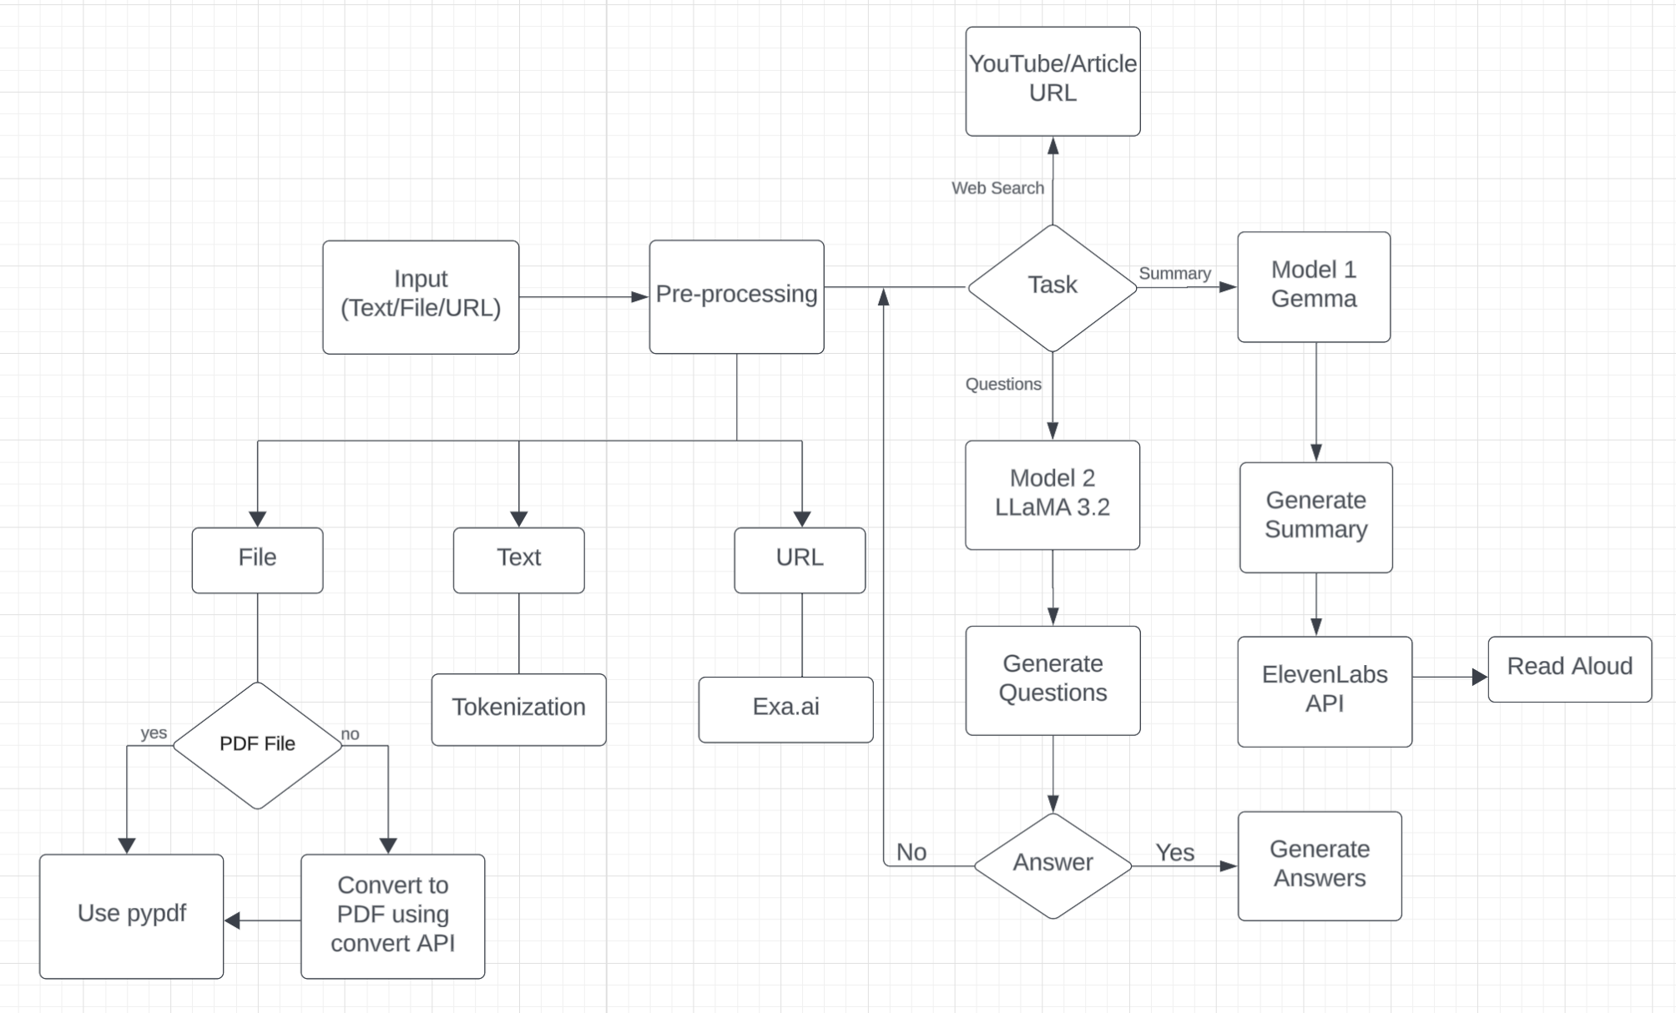
FLOWCHART:
10

Slide 11
MODEL IMPLEMENTATION:
Process:
Data preprocessing: using NLP techniques, pypdf, convertAPI and web scraping
Context and QA Pipeline:
• Model 1 GEMMA2: Summarization
• Model 2 LLaMA 3.2: Question-Answer Generation
Evaluation: Use metrics like ROGUE to determine how model is performing
Deployment: Build a user-friendly interface using Streamlit
11

Slide 12
LLaMA 3.2
What is LLaMA 3.2?
Large Language Model by Meta (3rd generation)
Employs a decoder-only architecture
Reason for Selection:
LLaMA 3.2
Decoder models excel at generating coherent and contextually relevant text
Outperforms many larger models in terms of efficiency
12

Slide 13
GEMMA2
What is GEMMA2?
Lightweight and open-weight LLM family by Google DeepMind
Reason for selection:
GEMMA
Despite being decoder-only, it excels in generating fluent & contextually accurate responses- key for summarization
Works well with prompt-based summarization due to instruction-tuned checkpoints
13

Slide 14
TOOLS LIST
API
Software
Frontend
Tools
Ollama
Streamlit
VSCode,
Jupyter Notebook, Github
ConvertAPI EXA ElevenLabs
14

Slide 15
TIME SCHEDULE
15

Slide 16
TIMELINE
Week 1
Weeks 2-3
Weeks 4-7
Weeks 8-10
Weeks 11-12
Weeks 13-14
Selection of the Topic
Data Collection and Pre- Processing
Model Development
Interface & Quiz Generation Integration
Testing & Evaluation
Refinement
& Presentation
16

Slide 17
RESULTS
17

Slide 18
GITHUB
Our project can be found on GitHub
You can replicate our project in your local with the help of README provided
18

Slide 19
DEMO
You can find the demo of our project on YouTube
19

Slide 20
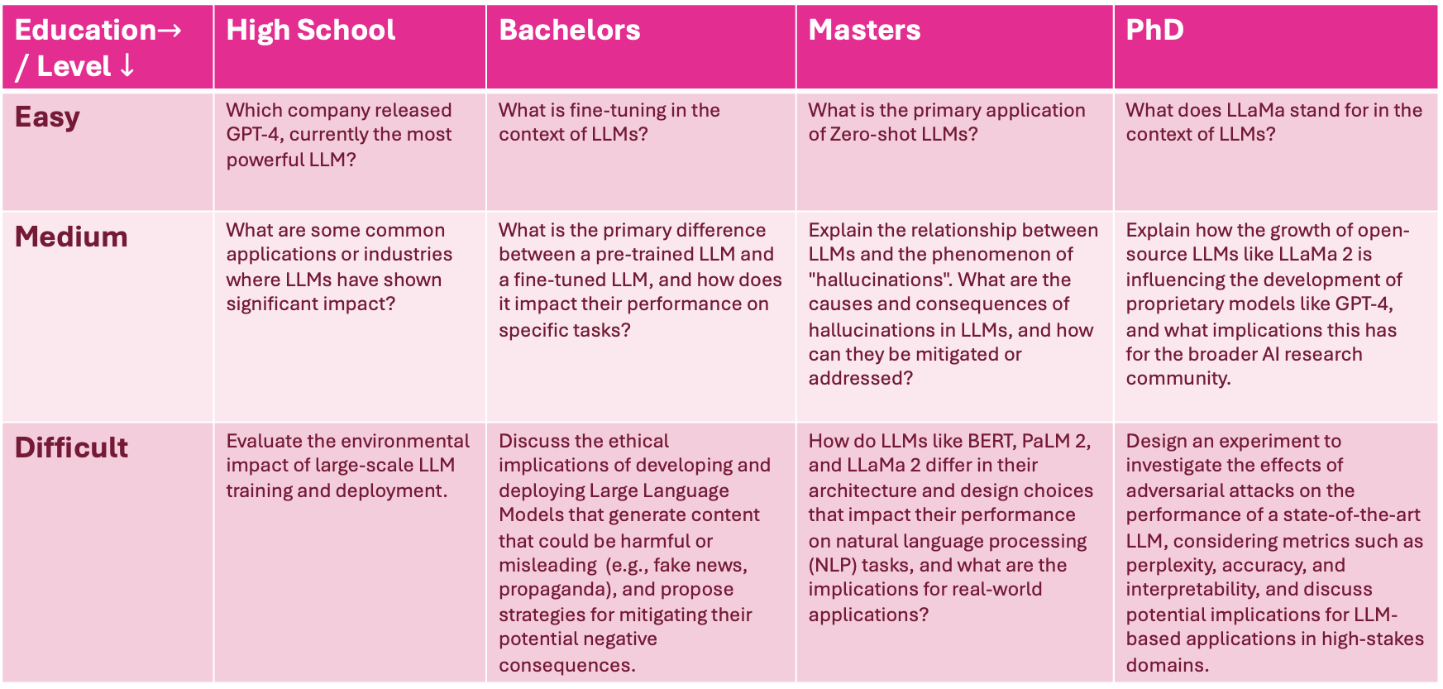
SAMPLE OUTPUT
Education$→\text{/ }\text{Level}↓$ | High School | Bachelors | Masters | PhD
Easy | Which company released GPT-4, currently the most powerful LLM? | What is fine-tuning in the context of LLMs? | What is the primary application of Zero-shot LLMs? | What does LLaMa stand for in the context of LLMs?
Medium | What are some common applications or industries where LLMs have shown significant impact? | What is the primary difference between a pre-trained LLM and a fine-tuned LLM, and how does it impact their performance on specific tasks? | Explain the relationship between LLMs and the phenomenon of "hallucinations". What are the causes and consequences of hallucinations in LLMs, and how can they be mitigated or addressed? | Explain how the growth of open-source LLMs like LLaMa 2 is influencing the development of proprietary models like GPT-4, and what implications this has for the broader AI research community.
Difficult | Evaluate the environmental impact of large-scale LLM training and deployment. | Discuss the ethical implications of developing and deploying Large Language Models that generate content that could be harmful or misleading (e.g., fake news, propaganda), and propose strategies for mitigating their potential negative consequences. | How do LLMs like BERT, PaLM 2, and LLaMa 2 differ in their architecture and design choices that impact their performance on natural language processing (NLP) tasks, and what are the implications for real-world applications? | Design an experiment to investigate the effects of adversarial attacks on the performance of a state-of-the-art LLM, considering metrics such as perplexity, accuracy, and interpretability, and discuss potential implications for LLM-based applications in high-stakes domains.
20

Slide 21
EVALUATION
21

Slide 22
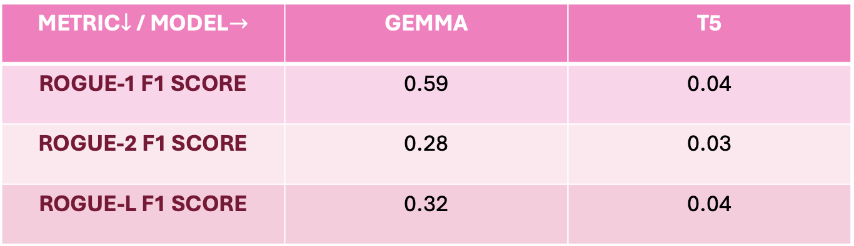
SUMMARIZATION
METRIC$↓$ / MODEL$→$ | GEMMA | T5
ROGUE-1 F1 SCORE | 0.59 | 0.04
ROGUE-2 F1 SCORE | 0.28 | 0.03
ROGUE-L F1 SCORE | 0.32 | 0.04
22

Slide 23
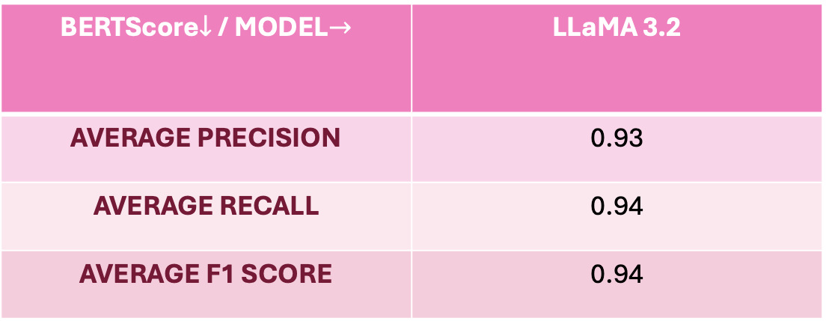
Q&A GENERATION
BERTScore$↓$ / MODEL$→$ | LLaMA 3.2
AVERAGE PRECISION | 0.93
AVERAGE RECALL | 0.94
AVERAGE F1 SCORE | 0.94
23

Slide 24
SUMMARY & REFLECTIONS
24

Slide 25
CHALLENGES
Ensuring that models from different platforms were compatible with our on-device setup
Latency and user data privacy
Adapting to different levels of user needs
25

Slide 26
FUTURE SCOPE
Multilingual support
Image as input
User login
26

Slide 27
LEARNING MILESTONE
Gowreesh | Katyaini | Priyanka
LLM Integration: Learned how to integrate and test various LLMs effectively as new models emerge. Software Engineering: Build robust and scalable applications with best practices. | Mastering LLM Integration: Discovered the best practices for seamlessly integrating and testing new Large Language Models as they become available. Career Growth: Strengthened AI and ML skills to advance in AI engineering roles | LLM Understanding: Gained deep understanding and hands-on experience of LLM architecture, foundations, applications, and deployment. Prompt Engineering: Developed skills to craft and optimize prompts for accurate model responses.
27

Slide 28
CONTRIBUTIONS
Gowreesh | Katyaini | Priyanka
Developed the initial software infrastructure. Integrated Streamlit with on-device LLM using Ollama. Implemented PDF ingestion and OCR capabilities. Actively participated in design discussions and trade-off evaluations. Stayed up-to-date with emerging technologies and assessed trade-offs for each approach. | Pitched ideas for the project. Updated prompts for better question generation. On device deployment of models using Ollama. Added a text box for input along with PDF file. Text box will disable if a file is uploaded. Added level of education dropbox and questions are being generated according to it Software Engineering: answer button will only appear once the questions are generated. Wrote the Project Report and created the final PPT. Managed communications within the team. | Exploration of project ideas and creating project proposals. Data analysis, developing the plots and documentation. On device deployment of models using Ollama. Model experimentation and implementation for summary generation. Prompt engineering for effective summarization. Model evaluation using ROUGE scores and finalizing the model. GitHub management and maintaining an updated README.
28

Slide 29
CONCLUSION
Model Variability: Different models exhibited varied responses to the same queries, with prompt design heavily impacting their performance
Processing Efficiency: Models when deployed locally, provided competitive performance, balancing efficiency and data privacy
Question Difficulty: The models were able to generate quiz questions of varying difficulty
29

Slide 30
REFERENCES
https://arxiv.org/pdf/2309.06358
https://arxiv.org/pdf/1904.09675
https://ieeexplore.ieee.org/abstract/document/10814828?casa_token=QECikUKVkKMAAAAA:CptjapTvwplnFCE6uhPx3yvUQe0N7jhrnCKkh2udftJaXn8ZD4fgOI6NrBDKP8I31r_eExdS_Rk
https://medium.com/data-science-at-microsoft/evaluating-llm-systems-metrics-challenges-and-best-practices-664ac25be7e5
https://python.langchain.com/docs/integrations/tools/exa_search/
https://ai.meta.com/blog/llama-3-2-connect-2024-vision-edge-mobile-devices/
30

Slide 31
Thank you! Questions?
31

